Slide 1
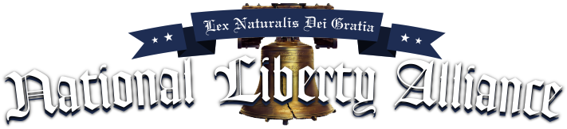
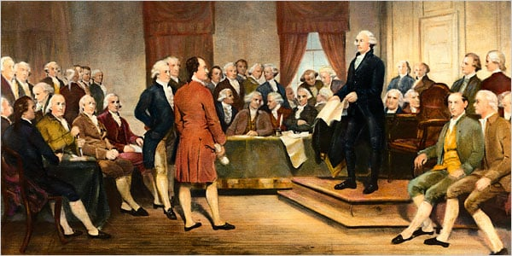
“Presents”
Government By Consent

Slide 2
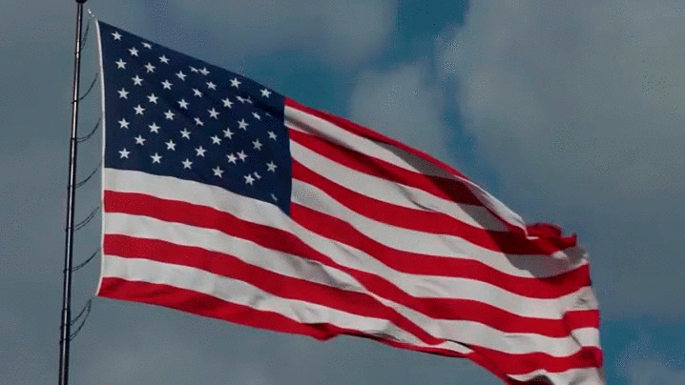
Psalms 33:12 Blessed is the nation whose God is the LORD; and the people whom he hath chosen for his own inheritance.

Slide 3
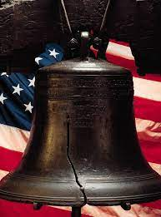
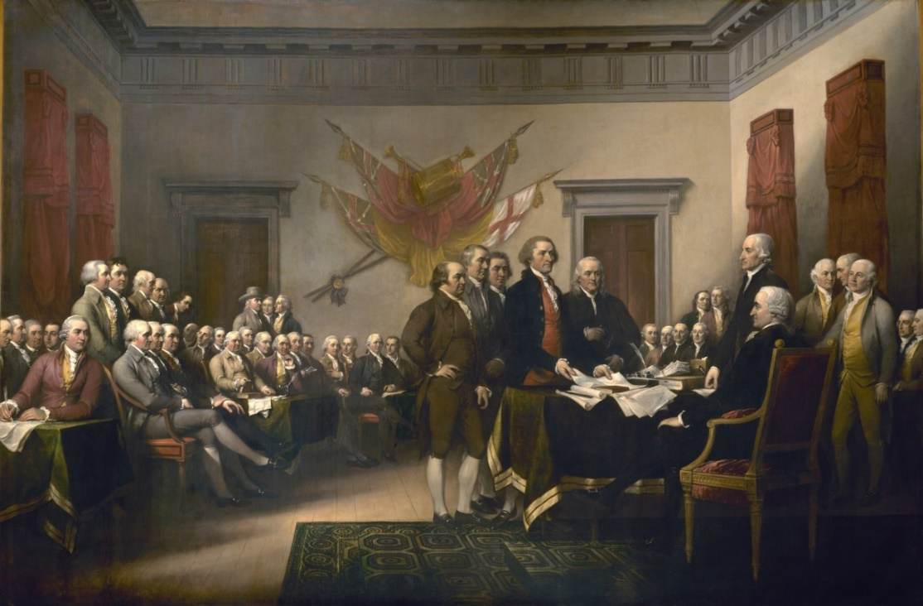
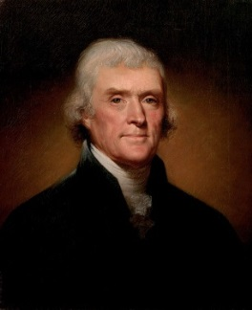
Government By Consent
An enlightened citizenry is indispensable for the proper functioning of a republic. Self-government is not possible unless the citizens are educated sufficiently to enable them to exercise oversight. It is therefore imperative that the nation see to it that a suitable education be provided for all its citizens.
“I know no safe depositary of the ultimate powers of the society but the people themselves; and if we think them not enlightened enough to exercise their control with a wholesome discretion, the remedy is not to take it from them, but to inform their discretion by education. This is the true corrective of abuses of constitutional power….
Educate and inform the whole mass of the people... They are the only sure reliance for the preservation of our liberty."
Thomas Jefferson

Slide 4
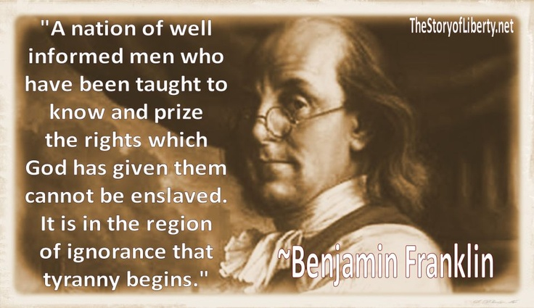
President Trump said, “In America, the people govern, the people rule, and the people are sovereign. I was elected not to take power, but to give power to the American people, where it belongs;”
The problem is that the People don’t know how to take and implement that power!
We the People must Learn the Science of Government by Consent!
Or Perish!!!

Slide 5
Thomas Jefferson said, "If people expect to be ignorant and free,
they expect what never was and never will be."
The purpose of NLA is to provide an on-line Venue where People can learn the Science of Government by Consent, organize Free and Independent Grassroots County Committees of Safety; And provide a place where Grassroots leadership from all 3134 counties can come together to find common grounds and discuss national issues and solutions. NLA facilitates a weekly Conference call every Monday from 9PM to 11 PM Eastern for this purpose.
NLA's mission is to restore the people to sovereignty through knowledge, and only then will they be armed with the virtue to take back political and judicial power. The people have it in their power to disarm and defeat the enemy of Liberty. Only the People can save our Republic.
NLA does not lead CCOS on issues, NLA only provides the tools and counsel for them to exercise their own discretion & God given right to have Government by Consent. We believe that education combined with common sense will lead us!

Slide 6
The United States was built upon 8 Ancient Biblical Principles, Founded by Thomas Jefferson
Sound government should be based on
1) Self-evident truths
2) The laws of nature and of nature's God.
3) All men are created equal
4) Unalienable Rights are bestowed upon us by God. Life, Liberty, and
the pursuit of happiness is Paramount.
6) Government is to preserve blessings of Liberty
7) Government by consent of the people
8) The right to alter or abolish
Thomas Jefferson said, “God who gave us life gave us liberty. And can the liberties of a nation be thought secure when we have removed their only firm basis, a conviction in the minds of the people that these liberties are of the gift of God? That they are not to be violated but with His wrath Indeed, I tremble for my country when I reflect that God is just that His justice cannot sleep forever."
The Declaration of Independence was a covenant with God where we desired to be under His Law and through our obedience receive His Blessings. God said, “This is the covenant that I will make with the house of My Son after those days, saith the Lord; I will put my laws into their mind, and write them in their hearts: and I will be to them a God, and they shall be to me a people:” - Hebrews 8:10

Slide 7
There are Two Power Structures Political and Judicial
By taking back the control of these two power structures places our destiny back in the hands of the People. But this is not possible if we don’t understand the political and judicial processes.
First of all People need to understand that we are a Natural Law Republic and that there is no place for political parties in a Natural Law Republic. Our founders told us that political parties only divide the People, thereby giving power to tyrants.
Second we must understand our Judicial Process and the Common Law. Our Heritage is in the Law and our Inheritance is Liberty. If we do not know the Common Law we will continue to lose our Liberty. If we do not know the Common Law how can we know when our servants violate the Law, thereby eroding our Liberty!
James Madison “Knowledge will forever govern ignorance, and a people who mean to be their own governors, must arm themselves with the power knowledge gives.”

Slide 8
The Following Is Found Under Education Starts Here Tab
NLA Provided Courses
Free Foundation Study
Free Civics Course
Free Constitutional Course 101
Free Militia Course
NLA Provided Courses for Premier Members
Government by Consent Course
Jury Administrative Accredited Course
A Premier Member is one who is supporting NLA donating $5 a month or more!
NLA provides a Free Higher Education found under our “Education Tab”
American History Biographies Butler Machiavelli
Bible Studies 5000 Year Leap Berkeley Boviers Law
Articles & Essays Federalist Papers Locke Blackstone vol 1&2
Federal Mafia Anti-Federalist Papers Hume Euclid's Elements
The Law Common Sense Adam Smith House/Philip Dru
Court Access and The Common Law How The Courts Work - Due Process
90 hour Law Course - $125.00

Slide 9
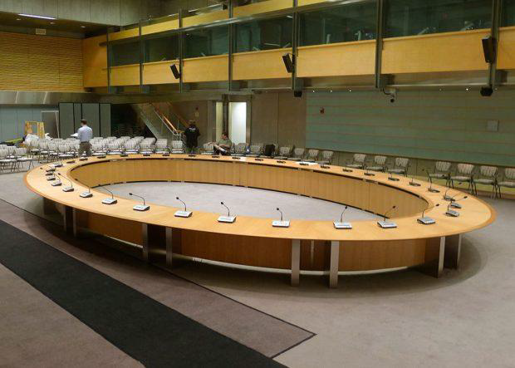
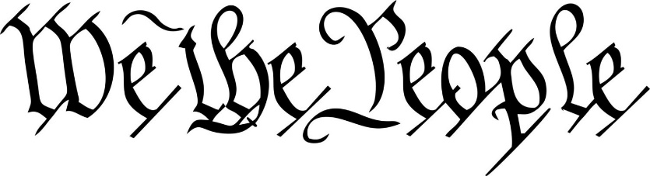
COUNTY COMMITTEES OF SAFETY
Will restore Political Power back to the People
Thomas Jefferson said, "we in America do not have government by the majority. We have government by the majority who participate."

Slide 10
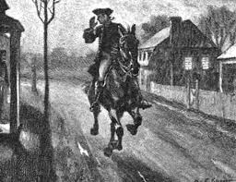
Committees Of Safety In Times of Trouble
Cambridge April 29, 1775
This may certify that the bearer, Mr. Paul Revere is messenger to the Committee of Safety and that all dispatch and assistance be given him in Instances that the business of the Colony may be facilitated
Jos. Warren, Chair.
Committees of Safety are community governance established in the absence of the ability of the existing governments to provide for the needs of civilized society. They are the civil bodies politic.
On the voyage from England to America, the Pilgrims created a civil body politic; the Mayflower Compact.
Jamestown also had a civil body politic.
While Britain claimed the colonies they neglected the colonies needs therefore our Founding Fathers legislated and governed themselves through Committees of Safety.
Committees of Safety called for the 1st Continental Congress
Committees of Safety called for the 2nd Continental Congress
Committees of Safety established the Declaration of Independence, Constitution, and the Bill of Rights.
Committees of Safety provide a government during the Revolutionary War
Our founders exercised Government by Consent after its founding through CCOS
We The People must resurrect the County Committees of Safety in every county!

Slide 11
WE MUST END POLITICAL PARTIES
In 1796, George Washington in his Farewell Address warned us that, “through the course of time cunning, ambitious, and unprincipled men would subvert the power of the people and seize for themselves the reins of government (the COS Committeeman) through private Associations. He went on to tell us that once they seized the reins of power [using the statutory committeeman controlled by party bosses and not the People] the parties (private associations) that would arise would;
  Destroy the very engines (the political process) which have lifted them to unjust dominion,
  Destroy the regular deliberation and action of the constituted authorities,
  Open the door to foreign influence and corruption, thus the policy and the will of one country will be subjected to the policy and will of another,
  Serve to organize division,
  Ruin public liberty,
  Stifle, control and repress,
  Foment occasional riots & insurrection,
  Kindle animosity of one part against another,
  Put in the place of the delegated will of the nation, the will of the party elite,
  Agitate the community with ill founded jealousies & false alarms,
  Undermine the Constitution which could not be directly overthrown,
  Distract the public councils and enfeeble the public administration,
  Drive the spirit of revenge,
  Leads to despotism”
  Washington concluded, “…parties are truly your worst enemy”

Slide 12
COUNTY COMMITTEE OF SAFETY WILL RESTORE
Political Power from the two party system back to the People
Our Heritage – The Law of the Land
Blessings of Liberty – Our Inheritance
Common Law Grand & Petit Jurys
Rules of Common Law
County Militia
Lawful Money
Our Common Law Courts
Government by Consent
Constitutional Sheriffs
Provide a Proper Education
Force a Republic Review
This can only be accomplished by Free and Independent CCOS
At the Grassroots!

Slide 13
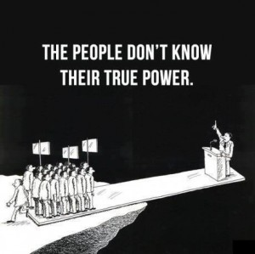
COUNTY COMMITTEE OF SAFETY IS
“GOVERNMENT BY CONSENT”
GENERAL COMMITTEE
⬄ Chairman ⬄ Co-Chairman ⬄ Secretary ⬄ Treasurer
SUB COMMITTEES
Committee of Correspondence
Political Action Committee
Judiciary Committee
Education Committee
Militia Committee
Other Committees as determined by the General Committee
Step by step instructions to set up a COS can be found at
www.nationallibertyalliance.org/handbooks

Slide 14

GENERAL COMMITTEE
Unlike the statutory committeemen there is no limit to the number of People who would like to join the CCOS. The General Committee is the governing Committee that everyone is a member of and gets one vote; no proxy votes. This committee receives the reports from the sub-committees and then all members vote on the issues brought before them. This committee is responsible to initiate all the necessary sub-committees and should pass the donation can at every meeting or agree on dues to fund your expenses.
George Washington’s Farewell Address on 19th September 1796, said, “Political parties obstruct the execution of the laws with the real design to direct, control, counteract, or awe the regular deliberation and action of the constituted authorities. Political parties serve to organize division and thereby give an artificial and extraordinary force; to put in the place of the delegated will of the nation the will of a party.
Samuel Adams “If ever a time should come when vain and aspiring men shall possess the highest seats in government, our country will be in need of its experienced patriots to prevent its ruin.”

Slide 15
COMMITTEE OF CORRESPONDENCE
This committee is responsible for addressing unconstitutional government activity and correspond with other committees of correspondence in order to share solutions and work on problems that affect other counties within your state or across our Nation.
This Committee is also responsible for working with the “Political Action Committee” during the Primaries in order to coordinate with other Counties the walking of “Designating Petitions” to fill political vacancies for the general election with Statesmen.
This Committee is also responsible for registering and communicating with NLA’s Director of Correspondence who can assist with solving problems, legal challenges, education, etc.
National Liberty Alliance will assist and advise only when asked and will never interfere with the issues effecting a County Committee of Safety unless asked. NLA is only assisting in the development of COS’s in all 3,134 Counties in order to save our Republic. NLA hopes that all CCOS’s endeavor to organize in the offered framework provided in order to have uniformity and thereby be able to communicate and work with their neighboring COS’s.

Slide 16
POLITICAL COMMITTEE
This committee is responsible for taking on the responsibility as Committeemen, presently the Committeeman process is codified and controlled by party bosses that serve the “Deep State” and not the People. Common Law liberates the People while the present system is repugnant to Liberty as it suppresses the will of the People.
This Committee is responsible for working with all political sub-division (such as town, village, congressional, state senate, etc.) with other County Political Committees to set a time and place for interviewing candidates to fill political vacancies.
This committee reports the interview dates to the “General Committee” for notification to all COS members who have a duty to attend the interviews for candidates within their respective political subdivisions and walk designating petitions for candidates they support to get them on the ballot.
This Committee is also responsible for monitoring our elected officials and contact them for correction when they violate their oath. And if necessary work with all related COS’s within the political subdivision for “Recall.”
SEE the “COS Committeeman Handbook” at www.nationallibertyalliance.org/handbooks for in-depth instructions on the Committeeman process. All People should have the opportunity to participate in this process without party restrictions and exclusions.
NLA will provide instructional videos and support for this important political process.

Slide 17
JUDICIARY COMMITTEE
This committee is responsible for filling Jury Administrative positions whenever there is a vacancy. Each county needs four Jury Administrators and one paralegal secretary who is also an Administrator. These are paid positions and require special training. NLA will provide that training and certification. These Administrators will work together in every county to restore the Law of the Land by resurrecting common law and common law rules in our courts.
This Committee is responsible for assisting People with problems with bureaucrats or legal matters. This committee is made up of the Five Trained Jury Administrators who will advise other committees on legal matters. NLA will assist and advised when asked.
This Committee will choose a chairman and the other four are co-chairs. Although it is encouraged that all Administrators attend the general monthly meeting at least one Administrator must attend the General Meeting to give an account and/or legal advice.
The General Committee will be responsible to judge any charges made by other Administrators against an Administrator who violates their oath for consideration of removal from their position.

Slide 18
EDUCATION COMMITTEE
This Committee is responsible for encouraging and assisting members in their education.
And for visiting grammar schools, high schools and colleges to require them to teach our children Civics, Common Law, American History, Our Founding Documents, Due Process, how our courts work, and bring the Bible back to our schools; as was the will of our founding fathers when in 1789 Congress and President George Washington passed and signed into Law the United States Annotated Code, Article III which states; “Religion, morality, and knowledge, being necessary to good government and the happiness of mankind, schools and the means of education shall forever be encouraged.”
Federal law passed in 2004 requires that all schools that receive federal funding provide a course to all students on the Constitution. The law is known as H.R. 4818, and the text is found at section 111 (b): This legislation is weak but We the People can demand more from our children’s schools.
This Committee will communicate with all citizens within various school districts inviting them to a General Committee to discuss what they are going to require of the various school boards they are scheduled to meet with next. NLA will work with the Judicial Committee to remove boards who will not yield to the will of the People.
This Committees will be the most powerful committee to bring in new members to the County Committee of Safety.
NLA will soon be working on a suitable curriculum in Civics, American History, Common Law and our Founding Documents for various grade levels.

Slide 19
MILITIA COMMITTEE
This committee is responsible for restoring the organized and unorganized militia within their respective counties, it is the duty of this committee to participate in a state wide meeting with all County Militia Committees at least once a year. We should look for an existing militias within your counties to invite them to join, work with, and help the CCOS in this endeavor. This committee should instruct all members in their duty as part of the militia. See “Militia Codes Rules and Resolutions Handbook” found at www.nationallibertyalliance.org/handbooks
We should look to x-military and law enforcement for assistance in organizing and training. For information and instructions contact NLA’s Militia Director who will assist with solving problems, legal challenges, etc. It is extremely important for county militias to be corresponding with other county militia committees and plan a coordinated yearly state wide event on Independence day.
John Adams said, “The Forth Day of July 1776, will be the most memorable Epoch, in the History of America.—I am apt to believe that it will be celebrated, by succeeding Generations, as the great anniversary Festival. It ought to be commemorated, as the Day of Deliverance by solemn Acts of Devotion to God Almighty. It ought to be solemnized with Pomp and Parade, with Shews, Games, Sports, Guns, Bells, Bonfires and Illuminations from one End of this Continent to the other from this Time forward forever more.”

Slide 20
Handbooks & Instructions
Found Under Start a Committee of Safety Tab
CCOS Organization Structure
CCOS Organizing Handbook
CCOS Charter
CCOS Resolutions
CCOS Committeeman Handbook
CCOS Vow
CCOS Seal
CCOS National Disaster Plan
Militia Codes Rules & Resolutions
Grand Jury Handbook
Petit Jurist Handbook
Sheriffs Handbook
Common Law Handbook
Approaching the Sheriff
Republic Review
Manual of Arms
Jury Administrator Plan
Power & Authority of The County Sheriff
Posse Comitatus Act
Ham Introduction Flyer
Plan To Save Our Republic
Two sided Flyer
Committees of Safety flier
Two pennys worth
Militia Codes and Rules
Robert Rules Introduction
Robert Rules of Order
Robert's Rules of Order Motions Chart
Roberts Rules of Order Basic Principals
Roberts Rules of Order Simplified
National Militia Alliance Bullet Points and Resolutions
Useful Excerpts From Marbury v Madison & US vs Williams 1992

Slide 21
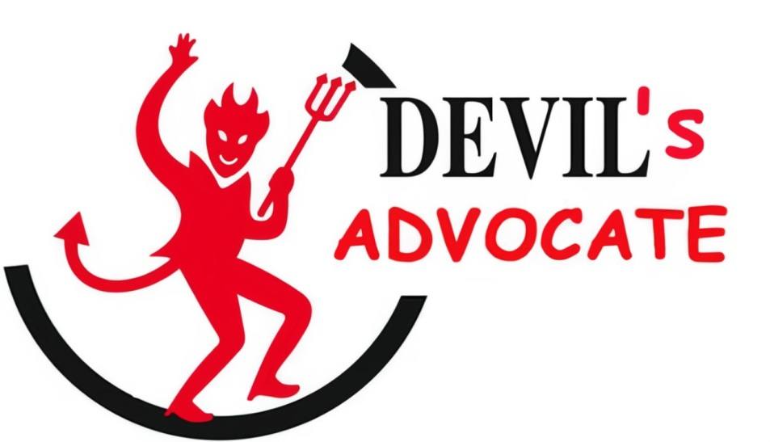
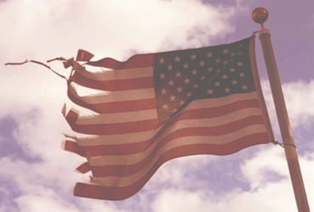
WE MUST END THE AMERICAN BAR ASSOCIATION
THE
In 1750, the British BAR was established in the colonies to abrogate the Common Law and suppress the beginning of the American rebellion instigated by Benjamin Franklyn.
In 1878, seventy-five lawyers hell-bent on the destruction of our Constitutional Republic established the American Bar Association which played a pivotal role in the abrogation of our common law.

Slide 22

THE AMERICAN BAR ASSOCIATION THE
The ABA has seized control of our government at every level through the Deep State; whereas, no decision is made, no law is passed and no issue is resolved without the seditious BAR orchestrated legislation intended to regulate our Liberties and eventually abolish them; a necessity for their NWO.
In 1819, the original ratified 13th Amendment that prevented BAR members from holding an office of trust was removed by the ABA controlled Congress and replaced it with another sometime between 1865 and 1868.
If any citizen of the United States shall accept, claim, receive, or retain any title of nobility or honour, [BAR lawyers have the title of high honor above gentleman, and below knight called “Esquire”] or shall without the consent of Congress, accept and retain any present, pension, office, or emolument of any kind whatever, from any emperor, king, prince, or foreign power, such person shall cease to be a citizen of the United States, and shall be incapable of holding any office of trust or profit under them, or either of them.

Slide 23
THE AMERICAN BAR ASSOCIATION THE
In 1871, the ABA controlled Congress created a foreign state (USA Inc) within a state within a city (Washington DC) through the Organic act of placing the United States under the control of foreigners via the deep state.
In 1913 the ABA controlled Congress removed the states right of suffrage through the Senate thereby enslaving the states through the “unratified” and anti-constitutional 17th Amendment.
In 1913, the ABA controlled Congress enslaved the People under the Federal Reserve Act which gave complete control of the dollar to foreign bankers subjecting the People to debtor’s prison.
In 1922, the NY ABA announced that it planned a vigorous state wide campaign to abolish the Grand Jury institution.

Slide 24
THE AMERICAN BAR ASSOCIATION THE
In 1934 the ABA controlled Congress passed the “Rules Enabling Act,” whereas according to the Federal Judicial Center, a government agency, on September 16, 1938, pursuant to its fictional authority under the repugnant “Rules Enabling Act” stated, “the Supreme Court enacted uniform rules of procedure for the federal courts. Under the new rules, suits in equity and suits at common law were grouped together under the term “civil action,” claiming that “rigid application of common-law rules brought about injustice.”
In 1947, the ABA controlled Congress initiated the national police state surveillance grid. Today, the CIA is a private corporation which operates as a prostitute for global banking interests and does not represent the United States.
In 1948, the ABA controlled Congress created the United Nations on American soil marking the beginning of the end of political sovereignty in the United States.
In 1950, the 81st Congress Investigated the Lawyers Guild and determined that the ABA organization was founded and run by communists. Thus any elected official that is a member of the ABA will only be loyal to the ABA and not the people.
In 1962, the ABA controlled Congress outlawed the Bible and Prayer in the classroom, marking the beginning of moral decay in America.

Slide 25
THE AMERICAN BAR ASSOCIATION THE
In 2001, the ABA controlled Congress passed the Patriot Act and now today virtually every communication that we engage in is monitored.
In 2002, the ABA controlled Congress established the Department of Homeland Security, TSA and FEMA which during a national emergency controls every resource, every asset and even our freedom.
In 2012 the ABA controlled Congress via Title 8 USC 1481, 1952 declared Patriots willing to defend the Constitution to be terrorists.
The ABA controlled Congress have flooded our courts with nearly 150 years of repugnant acts, statutes and rules. All of the aforesaid destructive acts were possible because People were not paying attention to what their government was doing.
“The only remedy to lawlessness is the Law.” Therefore, We the People have the power to nullify all these unconstitutional repugnant acts simply through self-education and taking control of the judiciary through the Jury process and our political process through “Committees of Safety.”
Today the ABA is one of the world’s largest professional organizations, with nearly 400,000 members and more than 3,500 entities.

Slide 26
THE AMERICAN BAR ASSOCIATION THE
Today the ABA holds a monopoly over the minds of the federal and states judiciaries and attorneys that practice law in our courts. There are 204 ABA accredited law schools that are nationally accredited by the American Bar Association (ABA), and graduates of these schools may generally sit for the bar exam in any state.
There are 31 law schools that have not been approved by the American Bar Association. Some states permit graduates of these schools to take the bar examination or will admit to their bars a graduate of a non-ABA-approved law school who has been admitted to the bar of another state. Most states do not.
THE ABA SCHOOLS, in an act of treason, teach that “In law”, common law is the body of law derived from judicial decisions of courts and similar tribunals. Claiming that the defining characteristic of “common law” is that it arises as precedent, called Comity.
Whereas Common Law is “NOT” precedent or legislated law, where one size fits all, it is NOT civil law. Common Law aka Natural Law is governed by “maxims” written in the hearts of men aka Common Sense! Romans 2:14-15 When the Gentiles, which have not the law, do by nature the things contained in the law, these, having not the law, are a law unto themselves: Which shew the work of the law written in their hearts, their conscience also bearing witness, and their thoughts the mean while accusing or else excusing one another;)

Slide 27
THE AMERICAN BAR ASSOCIATION THE
Today, with almost a half a million BAR members, 80,000 of them are working in Washington DC. They have perverted the rule of law, deprived We the Sovereign People of due process and have supplanted our Article III courts with jurisdictions unknown.
18 U.S. Code § 2385 - Advocating overthrow of Government: … Whoever, with intent to cause the overthrow or destruction the government of the United States or the government of any State, Territory, District or Possession thereof, or the government of any political subdivision therein, prints, publishes, edits, issues, circulates, sells, distributes, or publicly displays any written or printed matter advocating, advising, or teaching the duty, necessity, desirability, or propriety of overthrowing or destroying any government in the United States by force or violence, or attempts to do so; … shall be fined under this title or imprisoned not more than twenty years, or both, and shall be ineligible for employment by the United States or any department or agency thereof, for the five years next following his conviction.
SOLUTION: Force the reinstatement of the “Original 13th Amendment that was ratified by our founding fathers in 1818

Slide 28
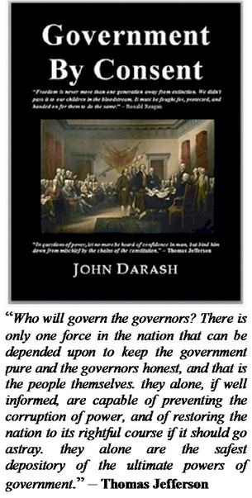
CAMPAIGN FOR CONSTITUTIONAL SHERIFFS
Our goal is to send a copy of the book, "Government by Consent" to every Sheriff in America and to follow up with a CCOS to support our Sheriff. We must educate all our 3,134 Sheriffs and the People in order to secure our Republic.
The Sheriff has a duty to protect the unalienable rights that are codified by We the People in the Constitution. The office of Sheriff was created through Natural Law to protect the sovereign.
“A Sheriff can and should interpose for his citizens against an overreaching federal, state or local government” – Sheriff Brad Rogers

Slide 29
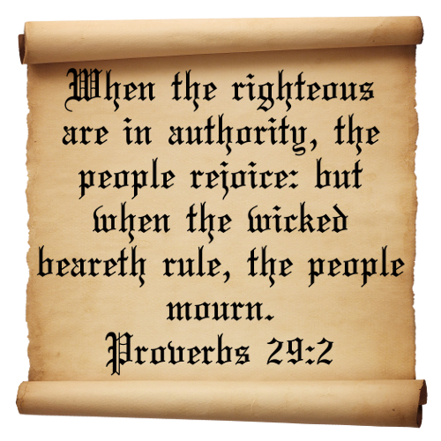
THE SOVEREIGN MAKES THE LAW
James Madison, “The people have an indubitable, unalienable, and indefeasible right to reform or change their Government, whenever it be found adverse or inadequate to the purposes of its institution.”
Samuel Adams, “The natural liberty of man is to be free from any superior power on Earth, and not to be under the will or legislative authority of man, but only to have the law of nature for his rule.”
Thomas Jefferson, “When injustice becomes law, resistance becomes duty.… If a government, either by malfeasance or neglect, fails to protect those rights - or, even worse, if the government itself begins to violate those rights - then it is the right and duty of the people to regain control of theirs affairs and set up a form of government which will serve the people better.”…“These rights which have been bestowed by the Creator, they cannot be altered or eliminated at any time; that is, they cannot be taken away or violated without the offender coming under the judgment and wrath of the Creator.”

Slide 30
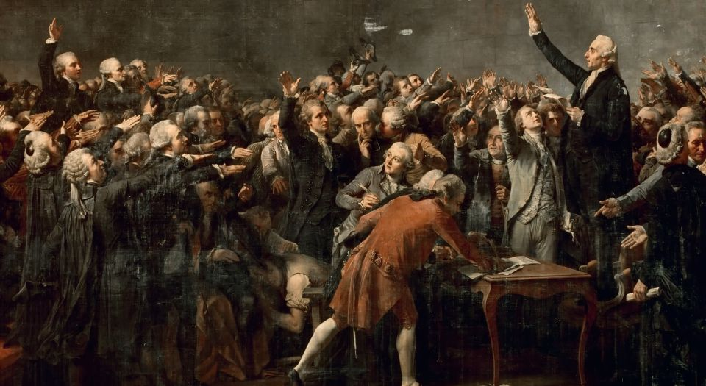
THE SOVEREIGN MAKES THE LAW
We the People have been providentially entrusted via Natural Law to dispense justice and were provided legal recourse to address the criminal conduct of the Judiciary and our Representatives.
“Under our system of government upon the individuality and intelligence of the [sovereign] citizen, the state does not claim to control them, except as his/her conduct to others, leaving him/her the sole judge as to all that affects them.” - Mugler v. Kansas
“Every man is independent of ‘all legislative laws, except those prescribed by nature. He is not bound by any institutions formed by his fellowman without his consent.” - Cruden v. Neale,
The very meaning of ‘sovereignty’ is that the decree of the sovereign, [not the government], makes law. A consequence of this prerogative is the legal ubiquity of the King [of kings]. His majesty [God] in the eye of the law is always present in all his [Natural Law] courts, though he cannot personally distribute justice. His judges [jurists] are the mirror by which the King’s image [God’s will] written in their hearts is reflected; for “laws are made for us; we are not made for the laws.” - American Banana Co. v. United Fruit Co.,

Slide 31
THE SOVEREIGN MAKES THE LAW
Unified United States Common Law Grand Jury
AL, AK, AZ, AR, CA, CO, CT, DE, FL, GA, HI, ID, IL, IN, IA, KS, KY, LA, ME, MD, MA, MI, MN, MS, MO, MT, NE, NV, NH, NJ, NM, NY, NC, ND, OH, OK, OR, PA, RI, SC, SD, TN, TX, UT, VT, VA, WA, WV, WI, WY:
We the Sovereign People never gave the legislators, judges or prosecutors any authority to call or address the “Common Law Grand Jury” directly. If the government wants to ask for an indictment they need to bring their evidence, including exculpatory evidence, to the Sheriff who will then consider the evidence and then decide to summons the Grand Jury or not. If the People want to bring criminal charges before the Grand Jury, they should address their case by sworn affidavit to the Sheriff who will at his discretion bring it to the Grand Jury.
In the U.S. Supreme Court case of United States v. Williams, Justice Antonin Scalia, writing for the majority, confirmed that; “The American grand jury is neither part of the judicial, executive nor legislative branches of government, but instead belongs to the people. It is in effect a fourth branch of government “governed” and administered to directly by and on behalf of the American people, and its authority emanates from the Bill of Rights.” The same would be true of the petit jury.
“The People have the unbridled right to empanel and preside over their own proceedings unfettered by technical rules and to investigate merely on suspicion.” It is the Grand Jury’s function to consider criminal charges whereas prosecutors have no authority to change or negotiate away the Grand Jury’s indictments. Indictments are final and any additional charges cannot be added without the consent of the grand jury.

Slide 32
THE SOVEREIGN MAKES THE LAW
Unified United States Common Law Grand Jury
AL, AK, AZ, AR, CA, CO, CT, DE, FL, GA, HI, ID, IL, IN, IA, KS, KY, LA, ME, MD, MA, MI, MN, MS, MO, MT, NE, NV, NH, NJ, NM, NY, NC, ND, OH, OK, OR, PA, RI, SC, SD, TN, TX, UT, VT, VA, WA, WV, WI, WY:
Thomas Jefferson the Man Who Discovered Americas Freedom formula said, “
I have so much confidence in the good sense of man, and his qualifications for self-government, that I am never afraid of the issue where reason is left free to exert her force. Educate and inform the whole mass of the people. They are the only sure reliance for the preservation of our liberty. I know of no safe depository of the ultimate powers of the society but the people themselves; and if we think them not enlightened enough to exercise their control with a wholesome discretion, the remedy is not to take it from them but to inform their discretion. The constitutions of most of our states assert that all power is inherent in the people; that they may exercise it by themselves, in all cases to which they think themselves competent, as in electing their functionaries executive and legislative, and deciding by a jury of themselves, both fact and law, in all judiciary cases in which any fact is involved. Leave no authority existing not responsible to the people. When governments fear the people, there is liberty. When the people fear the government, there is tyranny.”
Today, We the People demand the returned to the People the orientation of the juries through administrators certified and overseen by Committees of Safety within their respective counties; this is, “Government by Consent!”

Slide 33
THE SOVEREIGN MAKES THE LAW
Unified United States Common Law Grand Jury
AL, AK, AZ, AR, CA, CO, CT, DE, FL, GA, HI, ID, IL, IN, IA, KS, KY, LA, ME, MD, MA, MI, MN, MS, MO, MT, NE, NV, NH, NJ, NM, NY, NC, ND, OH, OK, OR, PA, RI, SC, SD, TN, TX, UT, VT, VA, WA, WV, WI, WY:
THE DE-FACTO COMMISSIONER OF JURORS is a person to whom a commission is directed by the government via unlawful legislation or a de-facto court. This term denotes an officer of some bureau or agency of the government who is charged with the administration of the laws relating to jurors. They are under the control of the government through statutes and therefore are part of today’s de-facto civil law courts & not part of the Common Law process.
The “Commissioner of Jurors” who is usually an ABA lawyer and owes fidelity to the BAR and the government would be the epitome of “Jury Tampering.” Therefore, the People via “Jury Administrators” educated and certified in common Law by the People themselves are the only lawful administrators of the juries. And are lawfully able to orientate and advise the jurors in the common law and their common law duties. National Liberty Alliance has accepted that responsibility to educate and certify “Jury Administrators.”
Government cannot legislate themselves authority to take this unalienable right from the People for this unalienable right is the epitome of “Government by Consent.” And if for no other reason, statutes are not part of the “Common Law Process” while all government agents are empowered and controlled by statutes that is authorized under the Constitution. And it is clear that Article I of the Constitution vested no such powers or authorities to do so. And if we did it would be “null and void” because it would be repugnant to the Common Law process!

Slide 34
THE SOVEREIGN MAKES THE LAW
Unified United States Common Law Grand Jury
AL, AK, AZ, AR, CA, CO, CT, DE, FL, GA, HI, ID, IL, IN, IA, KS, KY, LA, ME, MD, MA, MI, MN, MS, MO, MT, NE, NV, NH, NJ, NM, NY, NC, ND, OH, OK, OR, PA, RI, SC, SD, TN, TX, UT, VT, VA, WA, WV, WI, WY:
Quo Warranto Filed May 13, 2015
A writ, in the nature of a writ of right for the king, against him who claimed or usurped any office, franchise, or liberty, to inquire by what authority he supported his claim, in order to determine the right. It lay also in case of non-user, or long neglect of a franchise, or misuser or abuse of it; being a writ commanding the defendant to show by what warrant he exercises such a franchise, having never had any grant of it, or having forfeited it by neglect or abuse.
THIS IS AN EXTRAORDINARY JUDICIAL ACTION filed in all 94 Federal District Courts and served upon all parties. All Clerks are to perform their ministerial function under penalty of law - Whoever intercepts, obstructs or impedes will be prosecuted to the fullest extent of the law 18 USC §1512(b).2 This is a matter of national security and it is expected that the recipients, being oath-takers read and understand the nature and gravity of the contents of these papers. This official judicial process executed by the Unified United States Common Law Grand Juries concerning treason against the People of the United States of America in violation of the United States Constitution Article III Section 3 treason, 18 USC §2385 advocating overthrow of Government, 18 USC §2384 seditious conspiracy, 18 USC §2382 misprision of treason, 18 USC §2381 treason, 18 USC §1349 attempt and conspiracy, 18 USC §1622 subornation of perjury, 18 USC §115 treason, sedition, and subversive activities, and 18 USC §4 misprision of felony.

Slide 35
Unified United States Common Law Grand Jury
AL, AK, AZ, AR, CA, CO, CT, DE, FL, GA, HI, ID, IL, IN, IA, KS, KY, LA, ME, MD, MA, MI, MN, MS, MO, MT, NE, NV, NH, NJ, NM, NY, NC, ND, OH, OK, OR, PA, RI, SC, SD, TN, TX, UT, VT, VA, WA, WV, WI, WY:
THE SOVEREIGN MAKES THE LAW
WRITS & INFORMATIONS
Filed 2015 and 2016 all
94 Federal District Courts
15-05-15 Writ Quo Warranto
15-05-20 Mandamus to Sheriff
15-05-23 Mandamus Judges
15-05-27 Mandamus martial law
15-05-29 Mandamus 2nd Amendment
15-06-03 Mandamus Terroism
15-06-06 Mandamus subversion
15-07-10 Mandamus Governors
15-07-20 Mandamus US Supreme Ct
15-10-14 Information to Judges
15-11-15 Information SWAT
15-11-15 Show Cause Clerk & Judge
16-02-18 Mandamus Governors
16-02-22 Information Court
16-07-04 Declaration of July 4th 2016
16-09-26 Information Martial Law
Redress Of Grievances
Filed December 14, 2016
Judicial Notice to Magistrate
Congress Redress of grievance
Supreme Court Redress of grievance
President Redress of grievance
Information to President
Governors Redress of grievance
NY Governor Response by letter
Grand Jury Response to letter
Memorandum in Support of Jurisdiction
Memorandum Jury Tampering & Stacking
Information Martial Law
Memorandum Article III Courts
Memorandum Founding Documents
Memorandum of Facts
Memorandum Grand Jury Authority
United States Attorney Notice
Governor A. Cuomo
Memorandum Amendment II
Memorandum of Law on Law
Memorandum of Law on Standing
Cover Letter to Attorney General Sessions
Information Brief
Information to President
Writ of Error
Indictment Judge Kahn
Writ Mandamus to court officers
Magistrate Show Cause
President Elect Trump Letter
DECLARATION OF RESTORATION 8-17-19
Writ_Mandamus_to_Clerks.pdf
FILED AUGUST 17, 2019 - Decision & Order & Declaration to Restore the Law.pdf
FILED SEPTEMBER 3, 2019 - Decision & Order Concerning Merging of Equity & Law
FILED SEPTEMBER 9, 2019 - Judge Kahn 2nd Indictment.pdf
FILED SEPTEMBER 16, 2019 - FAKE_LAW & FAKE COURTS.pdf
FILED SEPTEMBER 25, 2019 - Writ Mandamus Federal Rule 2.pdf
FILED SEPTEMBER 30, 2019 - Writ Mandamus Info Republic.pdf
FILED OCTOBER 7, 2019 - Writ Mandamus 2.pdf
FILED NOVEMBER 16, 2019 - Amendment_II_Moved_for_Cause.pdf
FILED DECEMBER 17, 2019 - Act of Treason Federal Rule 2.pdf
FILED FEBRUARY 19, 2020 - Writ_Quo_Warranto_2nd_Amendment.pdf
FILED APRIL 6, 2020 - Review the Record.pdf
FILED APRIL 6, 2020 - IRS_Writ_Quo_Warranto.pdf
FILED AUGUST 31, 2020 - Writ Mandamus_to_SCOTUS.pdf
FILED JANUARY 1, 2021 - Final Order to - US_Supreme_Court_1-1-21.pdf
Memorandum Abrogation of the Law of the Land
Memorandum Acts of Treason
Memorandum Amendment II
Memorandum Amendment X
Memorandum Amendment XIII
Memorandum Article III Courts
Memorandum Court of Record
Memorandum Founding Fathers and Judiciary
Memorandum Grand Jury Authority
Memorandum Habeas Corpus
Memorandum High Treason
Memorandum Jurisdiction Natural Law
Memorandum Jury Nullification
Memorandum Jury Tampering & Stacking
Memorandum Law and Equity
Memorandum Natural v Civil Rights
Memorandum Non Judicial Foreclosure
Memorandum Petit Jury Authority
Memorandum Soverignty
Memorandum Statutes Codes Regulations
Memorandum Tax Courts
Memorandum USC Title 18
WRIT MANDAMUS TO US SUPREME COURT
A PREROGATIVE WRIT THE PEOPLE’S REMEDY
Filed February 2, 2023

Slide 36
Unified United States Common Law Grand Jury
AL, AK, AZ, AR, CA, CO, CT, DE, FL, GA, HI, ID, IL, IN, IA, KS, KY, LA, ME, MD, MA, MI, MN, MS, MO, MT, NE, NV, NH, NJ, NM, NY, NC, ND, OH, OK, OR, PA, RI, SC, SD, TN, TX, UT, VT, VA, WA, WV, WI, WY:
THE SOVEREIGN MAKES THE LAW
JOINDERS
Abendroth Brian
Anderson Theresa
Birsen James
Brooks Benjamin
Fareed Fard
Gregerson Debra
Gregerson Stephen
Gundersen Candace
Gurley Bruce
Hall Carey A
Hatton Ronald
Heinz Timothy
Hobby Matthew
Kapustin Oleg
King Greg A
Knight Benjamin
Koulinich Oksana
Lewis Dwayne
McQuarry Patricia
Mcquarry Patricia
Mehl Gavin
Nadler Joel 1
Ollis David
Paul Randy
Regec Ryan J
Rice Charlie
Roberts Kelli1
Rodriguez Elliot
Sara John
Sepehry Fard Fareed
Wilson Gale
Yorty Heatherlee
Zarinegar Sean
HABEAS CORPUS
Aaron Rabold Arianna Meyers
Berry Timothy Borseth Justin
Brian Jopson Campbell Robert
Cantrell Newton Carey Erica
Christina C. Jiron Congress Anwar
Crannell Christian Curtis Kimbrough
David Lee David Mongielo
Erica Carey Griffin
Grizzell Sheri James Vernon
Jan Pachnik Janie Sanders
Jiron Christina Johannes Wanda
Johnson Karla Jopson Brian
Justin Borseth Kapustin Oleg
Karla Johnson Kathryn Stuart
Kimbrough Curtis Ko Lily Helen
Lee David Lily Helen Ko
Louis Daniel Smith Lugaro Jesse
Mable Marson Mercer Russell
Meyers Arianna Newton Cantrell
Pachnik Jan Pollock Maud
Poulson Ronald Rabold Aaron
Ramirez Rolando Rolando Ramirez
Ronald Poulson Sanders Janie
Sara John Sheri Grizzell
Shirearl Taylor Smith Louis Daniel
Stuart Kathryn Szach Anthony
Taylor Shirearl Vernon James
NON-JUDICIAL FORECLOSURES
Ann Galloway Asulu Williams
Awilda Lora Byron Gashler
Christie Reed Crystal Mack
Deborah Foster D’Annie Isra El
Elliot Rodriguez Fareed Fard
Felicia Collins Frederick J. Nuzzo
Harley W Blake Heather Dalton
Heriot Boyles Hiltrud Steimel
Janice Jackson Jan’e & Rudolph Colahar
Jeffrey Bryant Jeffrey Smiles
John Sprouse Joseph Eskel
Kenta Morris Leokadia Miglietta
Louise Gardner M Johnson
Mable Marson Mark Kleeman
Maud Pollock Michael Hammer
Nahimana Bey Paul Gonzales
Randy Paul Randall Grondwold
Robert Overheul Robert Hornbarger
Robert Rubio Ronald Poulson
Ronald Van Dyke Sergio Paul
Seth Rabold Shirearl Taylor
Theron Marrs Stephen Gregerson
Valtair Souza Thomas Anderson
Thomas Williams

Slide 37
Unified United States Common Law Grand Jury
AL, AK, AZ, AR, CA, CO, CT, DE, FL, GA, HI, ID, IL, IN, IA, KS, KY, LA, ME, MD, MA, MI, MN, MS, MO, MT, NE, NV, NH, NJ, NM, NY, NC, ND, OH, OK, OR, PA, RI, SC, SD, TN, TX, UT, VT, VA, WA, WV, WI, WY:
THE SOVEREIGN MAKES THE LAW
INDICTMENTS FOR DENIAL OF DUE PROCESS & FELONY RESCUE
Chief Judge Carin Schienberg Chief Judge David Nuffer Chief Judge Frederick J. Lauten Judge Lawrence E. Kahn
Chief Judge Kathleen Brickley Chief Judge Scott Needham Chief Justice Lenore Gelfman Chief Justice Paula Carey
Judge A C McKay Chauvin Judge Alfred J. Jennings, Jr. Judge Cortland Corsones Judge D. Hinrichs
Judge Daniel A. Ottolia Judge David J. King Judge Eddie Rodriquez Judge Francis Mathew
Judge George B. Turner Judge Gordon R. Burkhart Judge James Wilson Abrams Judge John Braxton
Judge John J. DiMotto Judge Jon Theison Judge Joseph Farneti Judge Juan B. Colas
Judge Kenneth J. Grispin Judge Lisa Porter Judge Lonnie Thompson Judge Mary Ann Sumi
Judge Michael P. Burns Judge Nathaniel J Poovey, Judge Patricia M. Lucas Judge Paul M Yatron
Judge Roger N. Nanovic Judge Sandra Champ Judge Sharon Devreis Judge Terence
Judge Thomas Michael Deister Judge Timothy M Wright Judge Toni E Clarke Judge Virginia A. Phillips
Judge Wallace A Lee Magistrate Judge Keith Rosa Master in Equity Marvin H. Dukes, III Chief Judge Robert J. Jonker,
Chief Judge Robert J. Jonke, Chief Judge Joy Flowers Conti, Chief Judge Joseph Normand Laplante, Chief Judge George H. King,
Chief Judge Ann L. Aiken, Chief Judge Marsha J. Pechman, Chief Judge Dana L. Christensen, Chief Judge Jerome B. Simandle,
Hon Mark A. Montour, Chief Judge David Gregory Kays, Chief Judge Linda R. Reid, Chief Judge Joseph Normand Laplante,
Chief Judge Phyllis Jean Hamilton, Chief District Judge Marsha Pechman, Chief Judge Janet C. Hall, Sam E Haddon,
Chief Judge Carol Bagley Amon, Chief Judge Ann Aiken, Chief Judge J. Daniel Breen,
INDICTMENTS FOR LAVOY FINICUM MURDER
& SELLING URANIUM TO RUSSIA
Hillary Clinton BLM Special Agent in Charge Daniel Love Harry Mason Reid
Attorney General Loretta Lynch FBI Director James Comey Oregon Governor Katherine Brown
FBI Special Agent Gregory T. Bretzing Grant County Commissioner Boyd Britton Sheriff David Ward
Judge Steven Grasty FBI Agent W. Joseph Astarita Magistrate Judge Peggy A. Leen
Magistrate Judge Carl Hoffman US Attorney Daniel G. Bogden US Attorney Steven W. Myhre
U.S. Attorney Nicholas D. Dickinson US Attorney Nadia J. Ahmed US Attorney Erin M. Creegan
Chief Judge Gloria M. Navarro Assistant U.S. Attorney Steven Myhre Magistrate Judge Michael R. Hogan
Chief Judge Ann L. Aiken Magistrate Judge Patricia Sullivan U.S. Attorney Amy E. Potter
U.S. Attorney Frank R. Papagni, Jr. Judge Anna J. Brown Magistrate Judge John Acosta
Judge Stacie F. Beckerman Judge Dustin Pead U.S. Attorney Billy J. Williams
U.S. Attorney Ethan D. Knight Assistant U.S. Attorney Geoffrey A. Barrow Assistant U.S. Attorney Craig Gabriel
Numerous John/Jane Doe(s) from multiple agencies (To be identified) which include, but are not limited, to the Local Police, State Police, BLM, FBI and NGO Contractors.

Slide 38
Unified United States Common Law Grand Jury
AL, AK, AZ, AR, CA, CO, CT, DE, FL, GA, HI, ID, IL, IN, IA, KS, KY, LA, ME, MD, MA, MI, MN, MS, MO, MT, NE, NV, NH, NJ, NM, NY, NC, ND, OH, OK, OR, PA, RI, SC, SD, TN, TX, UT, VT, VA, WA, WV, WI, WY:
THE SOVEREIGN MAKES THE LAW
Presentment
Anticipating Filing Sept 2024
The written notice taken by a grand jury of any offense, from their own knowledge or observation, without any bill of indictment laid before them at the suit of the government.
We the People Demand That, the United States Supreme Court do their sacred duty to, “Guarantee a Republican Form of Government” under Article IV §4 by restoring the Law of the Land, open the doors of Justice, and restore the People’s “Courts of Justice” that proceeds according to the course of “Common Law of the Land” under Article VI clause 2 without which, there is no Justice, or resign your office for not honoring the oath that you have taken, or face the wrath of this Grand Jury under Article III §3 for warring against the Constitution and We the People. This Presentment is not a prayer! It’s a demand by the sovereigns that vested you with power under Article III §1 & §2!
We the People are “Demanding Declaratory Judgments” that will restore our Courts of Justice, and obedience to the Law of the Land. If the United States Supreme Court cannot find the fortitude to enforce the LAW OF THE LAND upon their own then, because of the magnitude of the conspiracy being addressed in this Presentment the military will.

Slide 39
The United States Is A Christian Nation
Our founders who wrote the 1st Amendment prayed together and built America upon eight ancient principles derived from the Bible. Our courts are founded upon Common Law which is founded upon the Bible. Our founders believed that Liberty is a blessing from God founded in the Bible. They believed that the founding of America was by the Providence of God. They established a Court of Law and a court of equity founded upon biblical principles.
At the founding of our “Natural Law Republic,” the land of America was looked upon by majority as representing a New Jerusalem and/or a City upon a Hill and/or a New Israel drawing from II Samuel 7:10 where God said: “Moreover, I will appoint a place for my people Israel, and will plant them, that they may dwell in a place of their own, and move no more.”
Jesus Christ is the incarnation of God and there can be no doubt that most of our founders knew Jesus Christ and through His Word were in all likelihood sons of God. And they and many other sons were blessed with God’s Courts of Justice and Blessings of Liberty. Therefore, if we refuse to hold up the King of our Court, in our courts and our schools our Common Law Republic will be lost along with God’s Blessings of Liberty, our Founding Fathers were adamant about this.
Pledge of Allegiance – We are “One Nation Under God indivisible with Liberty and Justice for all.”
Article III Section 2 – “America’s Judicial system is under Common Law.”
The Liberty Bell in Philadelphia proclaims Leviticus 25:10 – “Proclaim Liberty throughout all the land unto all the inhabitants thereof.”
God said, 2 Chronicles 7:14 - If my people, which are called by my name, shall humble themselves, and pray, and seek my face, and turn from their wicked ways; then will I hear from heaven, and will forgive their sin, and will heal their land.

Slide 40
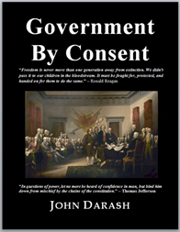
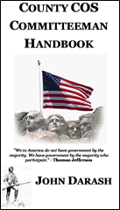
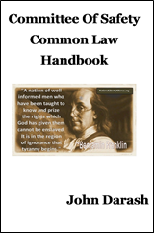
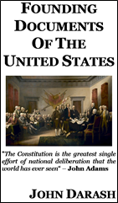
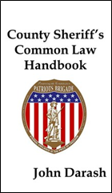
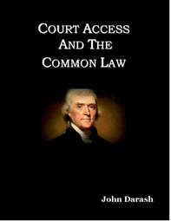
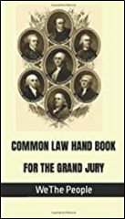
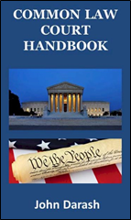
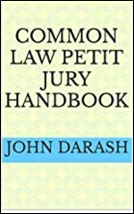
Books by John Darash Available on Amazon
Handbooks available for pdf free download. Or to bar on Amazon click the tab Under our Welcome tab www.nationallibertyalliance.org

